Slide 1


Driving Offline Sales for Kibbles ‘n Bits
Doug Chavez, Director, Digital Marketing, Del Monte
Andy Atherton, COO and Cofounder, Brand.net

Slide 2



Campaign Overview
Campaign Objective | Build brand presence and drive purchases for Kibbles ‘n Bits
Flight Dates | March 29, 2010 – April 30, 2010
Target Audience | US Females Aged 35-64
Contextual Channels | Casual Games, Communications, Entertainment News, Home, Pets, Women
Ad Formats | Standard and Expandable Banners
Ad Sizes | 728x90, 300x250, 160x600
Impressions & Reach | 65.5 MM Impressions, 15.4 MM Households
Media Budget | $203,000

Slide 3
SalesLink™:
Brand.net’s Econometrics Solution
Econometric studies provide statistically valid ROI measurement of offline sales in response to online ad campaigns
SalesLink™: Brand.net’s turnkey econometrics solution for CPG, including both media and measurement
Portal-based programs (i.e. Y!CD) and SalesLink™ target media differently
  Portal-based programs target purchasers by creating behavioral look-alikes
  Brand.net targets based on context, demographics and quality
Both Portal-based programs and SalesLink™ measure effectiveness exactly the same way

Slide 4
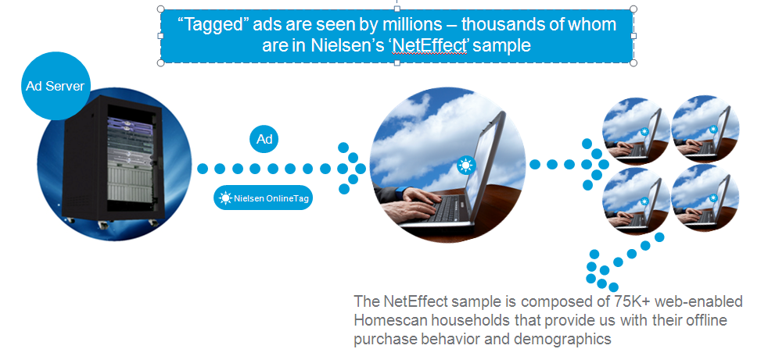
SalesLink™:
How Nielsen Gathers Data
Ad exposures are captured by ‘tagging’ campaign ad units prior to serving
Source: Nielsen

Slide 5
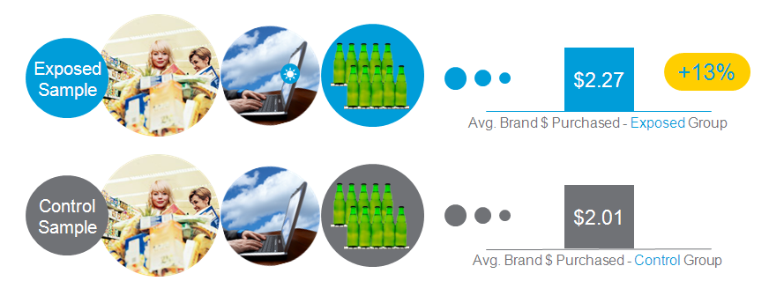
SalesLink™:
Nielsen Measurement Overview
Nielsen Homescan panelists exposed to campaign are identified
Exposed group examined and matched to a control (unexposed) group
Exposed & control groups are compared to isolate differences in product purchasing during and after the execution of campaign
Source: Nielsen

Slide 6
K’n’B Campaign: Impact on Sales
Dollar & pounds sales for Kibbles ‘N Bits were 13% greater among exposed households than control
Campaign exposure drove $1.5M in incremental sales for the brand at retail (approximately 2.2M pounds)
13% Lift
Source: Nielsen
Notes:
Made a format change above

Slide 7

That’s 2.2 MILLION POUNDS of Dog Food!

Slide 8
Unsurprisingly, K’n’B Also Took Share
Test period vs. Match period
(mid Mar 10-Jun 10 vs. mid Mar 09-mid Mar 10)
Source: Nielsen
Notes:
According to Ad Metrix, Mighty Dog was not advertising at the same time.

Slide 9
Impact on Purchase Intent
11% Lift
Source: Vizu Ad Catalyst
Notes:
The lifetime performance view is useful for understanding how well your campaign worked over time.

Slide 10
Fantastic ROI
($000s)
642%
ROI

Slide 11

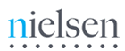
Intent Translating into Action
Awareness
Media Spend: $203,000
Consideration
Metric: Purchase Intent
11.1% lift in “top two box”, three month purchase intent
642%
ROI
Preference
Intent translating into action
Metric: Offline Purchases
Purchase
13% lift in sales within exposed group, $1,507,072 in incremental sales

Slide 12
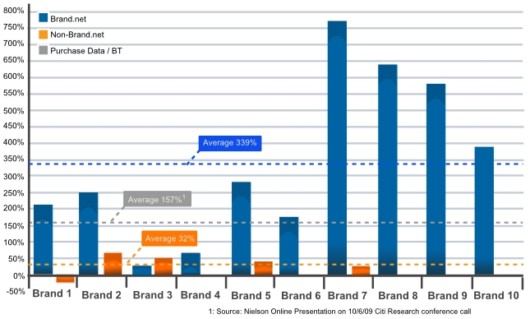
Brand.net Results
Brand.net media has delivered average offline purchase ROI of ~340%
Outperformed lifetime Nielsen average by >2X

Slide 13


Why doesn’t BT or “audience targeting” deliver better offline sales results?
Audience targeting (e.g.,“purchase-based” targeting) uses look- alike modeling for the vast majority of users and media delivered
Look-alike modeling identifies consumers with similar browsing patterns to actual purchasers
Purchasers identified within Nielsen panel population
  Nielsen panel = ~ 75K
  Purchasers = ~10K
No actual purchase data is available on the 99.9% of the users targeted
In the “purchase-based” targeting example, 99.9% of users based on contextual histories, not purchase data

Slide 14
Questions?
Doug Chavez
  doug.chavez@delmonte.com
  @dougchavez
Andy Atherton
  aatherton@brand.net
  415.860.8339

